Slide 1
Discus Throw
Dr. Rajeshwari

Slide 2
Introduction
To achieve maximum distance in the discus, the athlete will have to balance three components - speed, technique and strength. The information on this page is for a right-handed thrower.

Slide 3
The hold
Place the left hand under the discus for support
Place the right hand on top of the discus
Spread the fingers evenly but not stretched
The first joint of the fingers curling over the rim of the discus
Do not to grip the discus
Allow the discus to rest on the first joint of the fingers with the tips of the fingers over the rim.

Slide 5
Rotation
Figures 1 & 2
Adopt a shoulder-width stance and perform preliminary swings
Keep everything very long to provide maximum possible radius on the discus
Bodyweight in the middle of the stance
Aim for chin over knee over the toe on the left leg

Slide 6
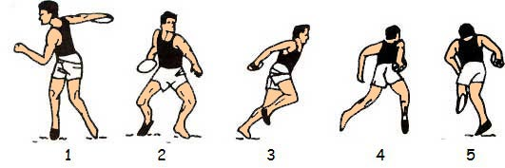

Slide 7
Figures 3 & 4
As the right foot leaves the ground the weight must be over the left leg
Discus kept high and relaxed, trailing behind the hips
Swing the right foot wide of the left foot into the centre of the circle
Figure 5
On grounding the right foot pivots on the ball of the foot
Keep the left foot low and fast

Slide 9
Figure 6
Discus held high and back
Keep the shoulders level and balanced
As the right foot lands aim for a chin over knee over the toe on the right leg
Keep the left foot low and fast
Figure 7
The real power position is at the moment the left foot contacts the ground
The left-arm points in the direction of the throw
Right foot pivots
The left side of the body is braced

Slide 10
Figure 8
Right hip has been driven forward - note the "bow" position
The right arm is extended and relaxed ready to strike
The left side kept firm and braced
Figure 9
The right arm comes through fast and last
The release angle (angle between the horizontal and the right arm) for the discus has to take into consideration aerodynamic lift and drag.
The left foot is kept grounded until well after the discus is released
Check right thumb is pointing forward and in line with the arm

Slide 11
Thanks

